Slide 1
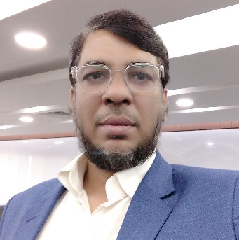
Feature Scaling
Aksadur Rahman
aksadur@yahoo.com

Slide 4
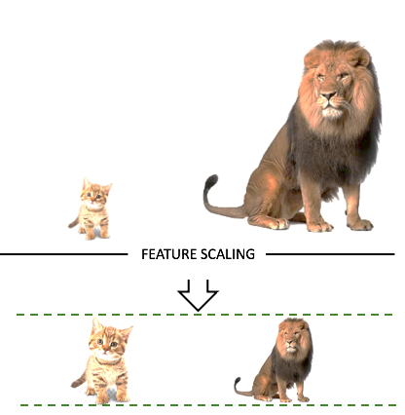

Slide 11
